Slide 1
NLP application
Day 1 – Introduction to NLP and Language Model

Slide 2
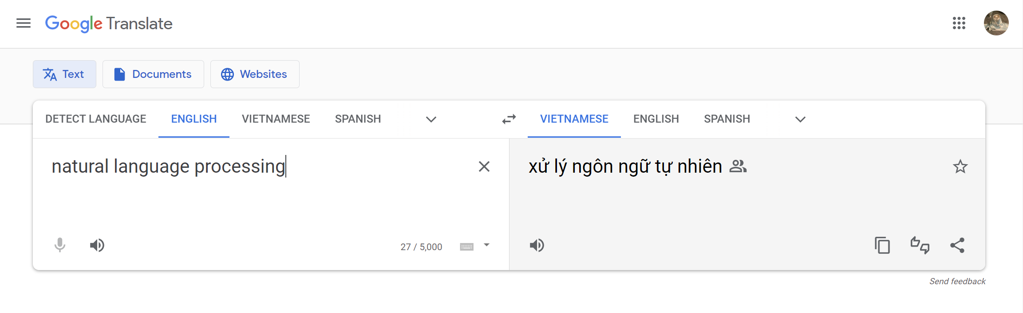
Machine translation
Input: text in foreign language
Output: text in desired language
Seq2seq

Slide 3
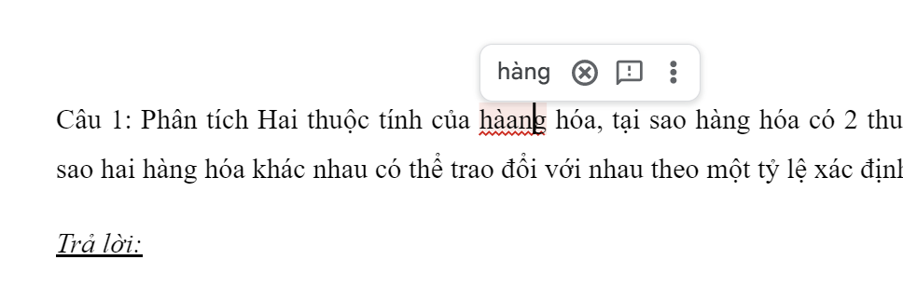
Grammar checking
Input: text with wrong grammar
Output: correction text
Sequence labeling

Slide 4
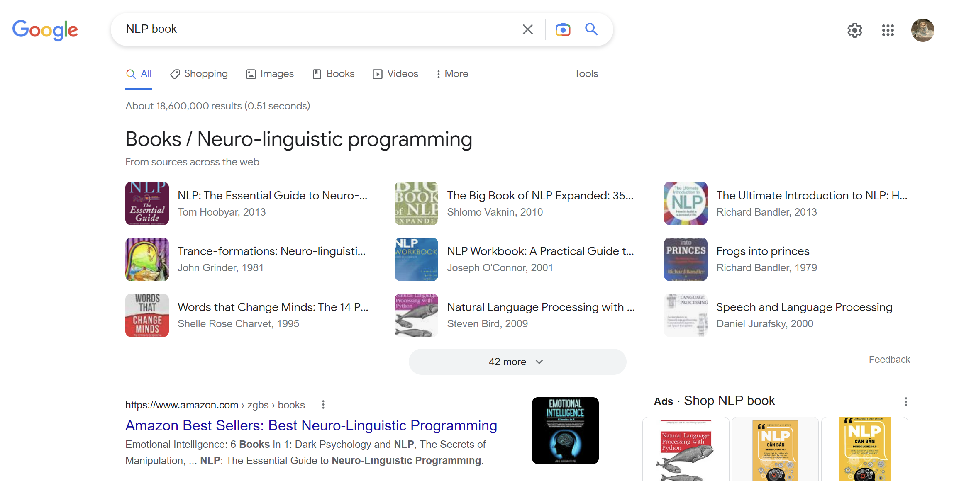
Recommendation system
Text classification

Slide 5
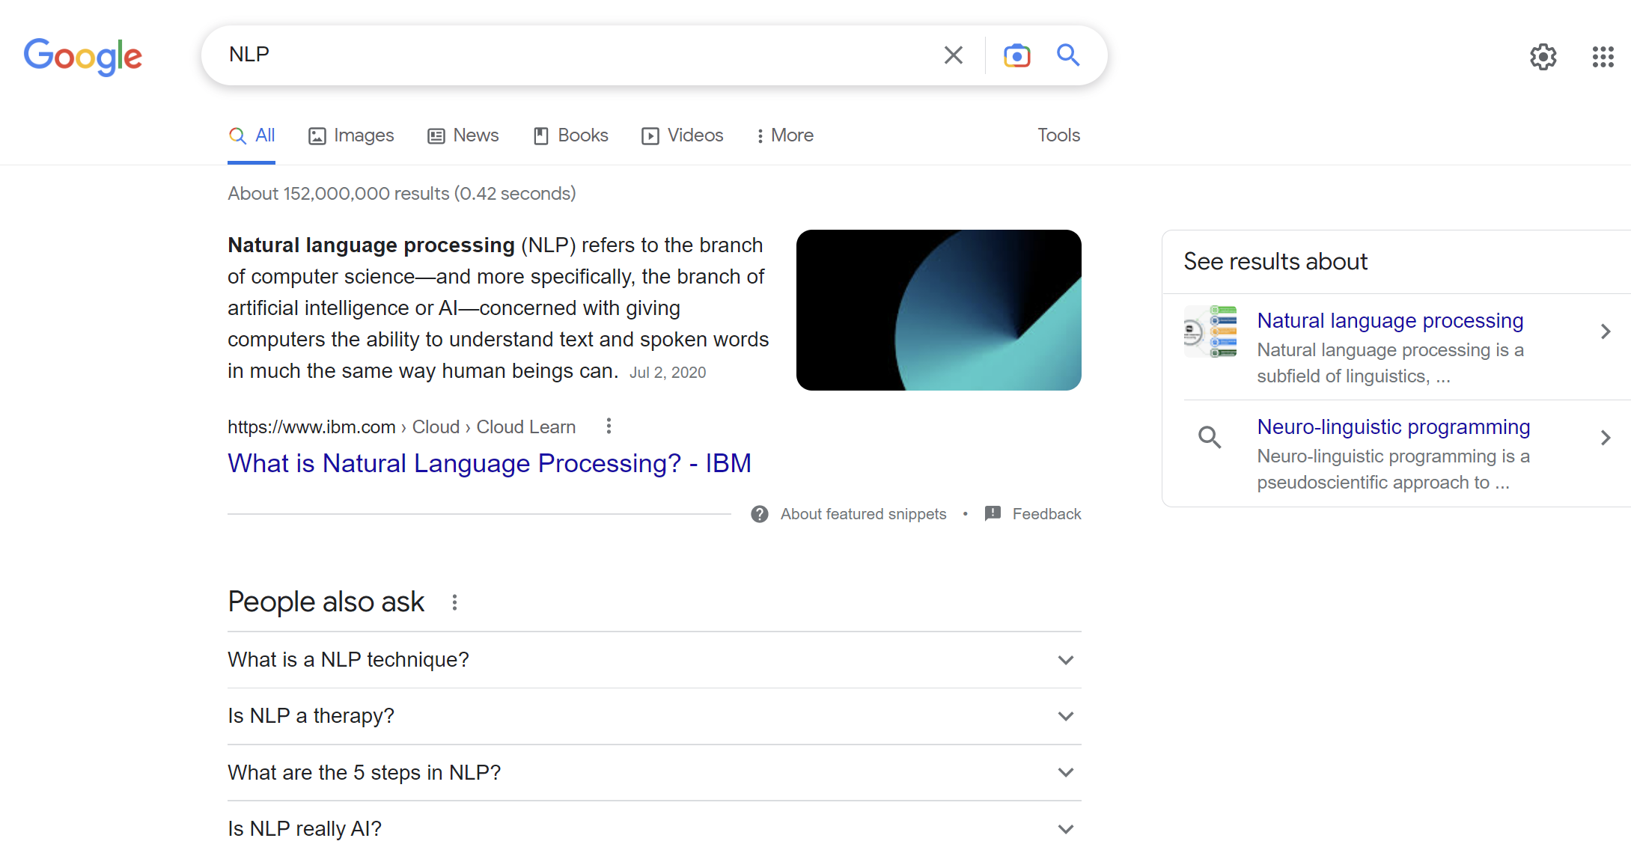
Search engine
Seq labeling

Slide 6
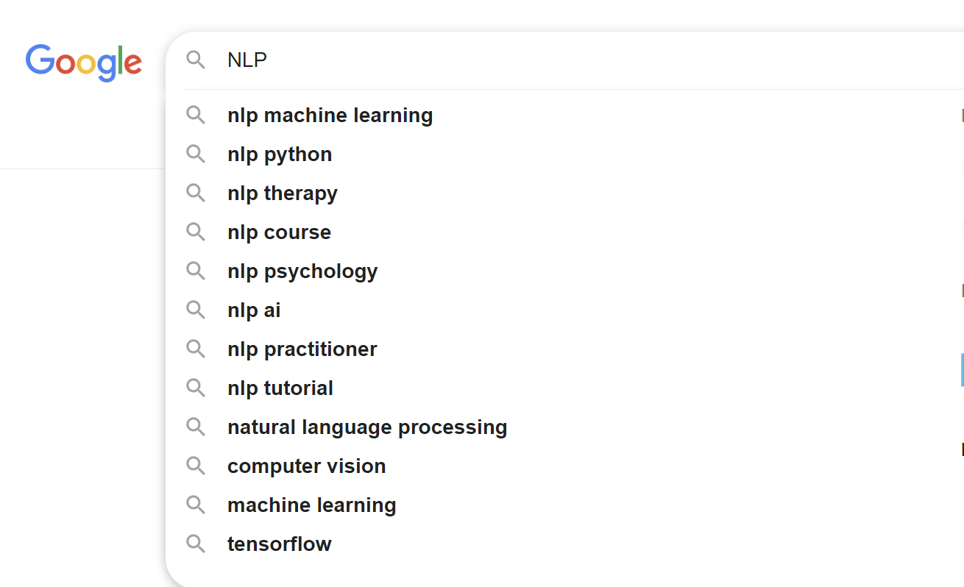
Writing suggestion
Text generation

Slide 7
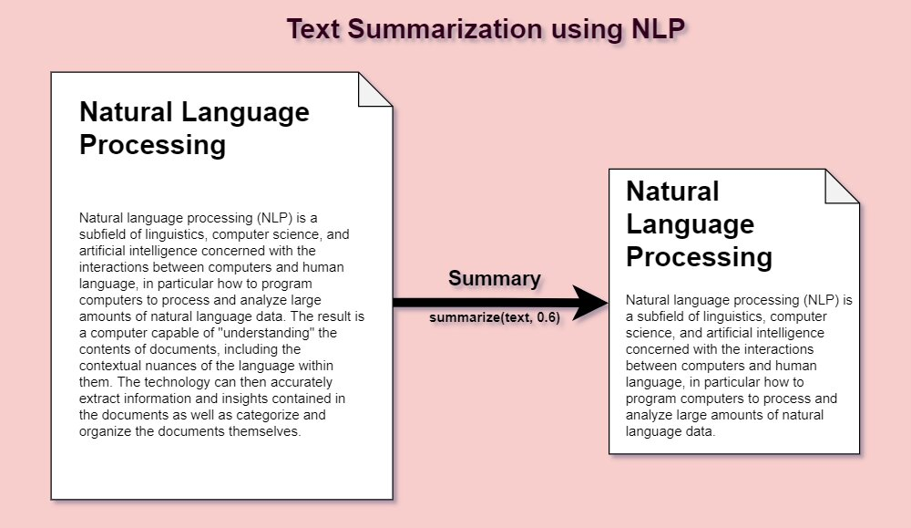
Text summarisation
Seq2seq

